Slide 1
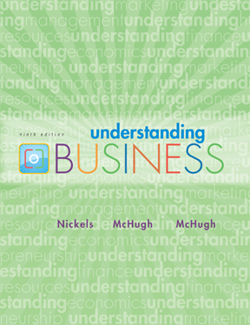
*
Chapter Thirteen
*
Marketing: Helping Buyers Buy
Speaker:
Tania Akter (TAK)
McGraw-Hill/Irwin
Copyright © 2010 by The McGraw-Hill Companies, Inc. All rights reserved.
Notes:
‹#›

Slide 2
What is Marketing?

Slide 3
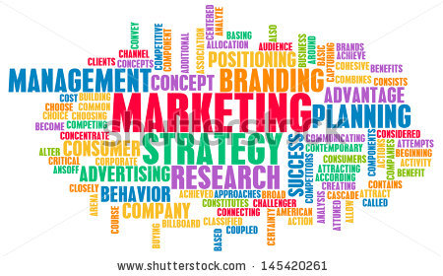
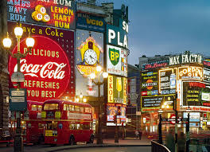

WHAT’S MARKETING?
*
What is Marketing?
*
LG1
Marketing -- The activity, set of institutions and processes for creating, communicating, delivering, and exchanging offerings with value for customers, clients, partners and society at large.
13-‹#›

Slide 4
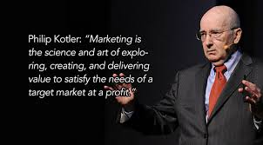

Slide 5
Learning Outcomes
By the end of this session, students will be able to:
Define what is marketing
Evolution of marketing
differentiate consumer and business market
explain how the marketers apply the tools of market segmentation
compare the business-to-business market and the consumer market

Slide 6
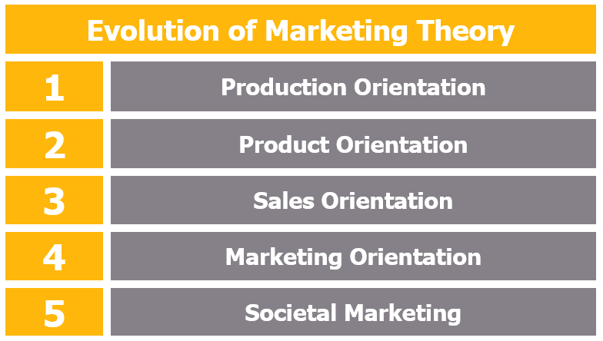
The Evolution of Marketing
The Production Era-more production and less expensive distribution and storage
The Product Era-This era brought about marketing beliefs that consumers will favor those products that offer the most quality, performance or innovative features. Marketing managers focus on making superior products and improving them over time.
The Selling Era -selling and advertising to persuade consumers
The Marketing Concept Era- customer orientation, service orientation, profit orientation
The Societal Marketing Era emphasizes on social responsibilities and suggests that to sustain long-term success, the company should develop a marketing strategy to provide value to the customers to maintain and improve both the customers and society’s well being better than the competitors.

Slide 7
DEVELOPING a PRODUCT
*
Designing a Product to Meet Consumer Needs
Product -- A good, service, or idea that satisfies a consumer’s want or need.
Price -- consider the costs of producing, distributing and promoting the product, which all influence the price.
Promotion -- advertising, personal selling; public relations, publicity; word of mouth and various sales promotion efforts.
Place -- Getting the product to consumers when and where they want is critical to market success
Brand Name -- A word, letter, or a group of words or letters that differentiates one seller’s goods from a competitor’s.
*
LG2
13-‹#›

